Slide 1


Turning Data to Dollars:
Strategic Insights to Boost
Sales, Profitability, and
Efficiency.
Olumide Balogun +234-8065060691

Slide 2


Table of Contents
Executive Summary
Objectives of the Project
Tasks / Questions : A Comprehensive Examination of Descriptive, Diagnostic, Predictive, and Prescriptive Analytics
Tools Used throughout the Project
Approach, Analysis, and Technical Challenges
Key Findings: Objective, Purpose, and Results (Hypotheses, Insights, and Interpretations from Visualizations and Models)
Final Recommendations
Olumide Balogun +234-8065060691
1

Slide 3

Executive Summary
The project, "Turning Data to Dollars: Strategic Insights to Drive Sales, Boost Profitability, and Improve Efficiency," harnesses the power of advanced data analytics to deliver actionable insights that fuel sustainable business growth. Using cutting-edge tools such as R, Tableau, and machine learning models, the analysis explored historical trends, identified key performance drivers, and predicted future trajectories.
This comprehensive analysis explored sales performance, profitability, and operational efficiency across multiple dimensions, including regions, categories, segments, and sub-categories. Key findings revealed opportunities to refine product strategies, strengthen customer engagement, and address areas of underperformance. Additionally, forecasts pointed to promising growth trends, backed by strategies tailored to capitalize on seasonal peaks and eliminate inefficiencies.
Leveraging the outcomes of descriptive, diagnostic, predictive, and prescriptive analytics, the company is well-positioned to achieve substantial revenue growth, enhanced profit margins, and a fortified competitive edge in the market.
Olumide Balogun +234-8065060691
2

Slide 4

Objectives of the Project
Accelerating Sales Growth: Unlock growth opportunities by analyzing historical sales data and key performance indicators (KPIs) to drive sustained revenue improvements.
Optimizing Profit Margins: Analyze profitability across regions, segments, and categories to refine pricing, reduce costs, and maximize margins.
Boosting Customer Loyalty: Target high-value customers and key sales segments with personalized campaigns and loyalty programs to strengthen retention.
Enhancing Product Strategies: Evaluate product performance to improve inventory efficiency, uncover cross-selling potential, and develop strategic product bundles.
Expanding Market Presence: Address performance gaps with tailored strategies to revitalize underperforming regions and amplify market competitiveness.
Strategic Forecasting: Apply time-series analysis to project sales over the next 36 months, enabling smarter resource allocation and proactive planning.
Driving Operational Excellence: Streamline sales, pricing, and inventory processes by eliminating inefficiencies and fostering business agility.
Olumide Balogun +234-8065060691
3

Slide 5

A Comprehensive Examination of Descriptive, Diagnostic, Predictive, and Prescriptive Analytics
Were there any years that experienced negative or stagnant growth? Moreover, are there significant differences within the data?
2a. How do sales performance vary across different segments within each region?
2b. How do profit performance vary across different segments within each region?
3a. How do sales performance vary across different product categories within each region?
3b. How do profit performance vary across different product categories within each region?
4a. How do sales performance vary across different sub-categories?
4b. How do profit performance vary across different sub-categories?
5. Can a distinct upward or downward trend in sales performance be identified over time?
How do the variables correlate with each other, and what is the strength and direction of
these relationships?
What are the key drivers that significantly contribute to sales performance and
profitability?
What are the predicted sales trends for the next 36 months, and how can these insights be
leveraged to drive favourable business decisions?
9. Which customers account for 80% of the business’s total sales?
10. Which products contribute to 80% of the business’s total sales?
Which customer segments, based on clustering, contribute the most to overall sales and
quantity?
What are the most common patterns and associations in customer purchases (e.g.
frequently bought items together)?
Olumide Balogun +234-8065060691
4

Slide 6

Tools Used throughout the Project
To conduct an in-depth analysis of the company's sales outlook, I used the following tools and technologies:
R: The backbone of my analysis, empowering me to clean and format data, conduct advanced analyses and modeling, create visualizations, and uncover critical insights. I relied on libraries such as dplyr, ggplot2, readr, lubridate, forecast, randomForest, psych, …
Tableau: A powerful data visualization tool I utilized to create interactive and dynamic dashboards, enabling stakeholders to explore sales trends effortlessly, monitor key performance indicators (KPIs), and evaluate geographic performance with clarity and precision.
PowerPoint: Essential for presenting complex findings, insights, and recommendations in a visually engaging and easily understandable way for stakeholders and decision-makers.
Git & GitHub: Vital for version control, sharing R scripts, and facilitating seamless collaboration and project tracking throughout the analysis process.
Olumide Balogun +234-8065060691
5

Slide 7

Approach, Analysis and Technical Challenges
1. Re-frame "Data Collection:
Obtained data tables from the management team for analysis.
2. Data Preparation:
Compiled, formatted, cleaned, and transformed the raw data into a unified and consistent dataset.
Addressed missing values, removed duplicates, and handled outliers to improve data reliability.
Corrected spelling errors and adjusted data types to ensure accuracy and consistency.
3. Data Enhancement:
Created calculated variables to support deeper and more meaningful analysis.
4. Exploratory Data Analysis (EDA):
Conducted detailed exploratory analysis using graphical visualizations and statistical techniques to uncover trends, patterns, and relationships within the data.
5. Advanced Analysis and Modeling:
Leveraged machine learning models and visual plots to identify key drivers of performance, Projection of sales, Pareto analysis, customer segments, and derive actionable insights.
Olumide Balogun +234-8065060691
6

Slide 8
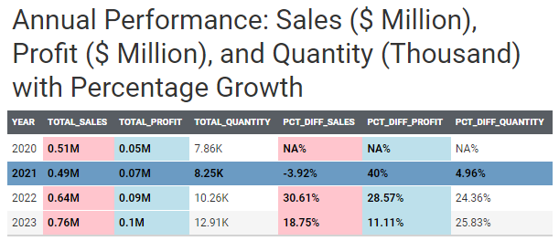
1. Yearly Breakdown of Sales, Quantities, Profits, and Percentage Growth
Task / Question : Were there any years that experienced negative or stagnant growth? Moreover, are there significant differences within the data?
Purpose: To identify periods of under- performance or stagnation and evaluate the significance of variations in key metrics, such as sales, profit, and quantity. This analysis aims to uncover potential issues that may require further investigation or strategic interventions.
Hypothesis: There are significant differences across the calculated fields.
Insights: 2023: A Year of Exceptional Growth In 2023, remarkable growth underscored effective scaling fueled by heightened demand, expanded market reach, and successful marketing or distribution strategies. This year emerged as the standout performer, achieving total sales of $767.37 million and a total profit of $98.08 million.
2021: Mixed Performance Amid Challenges Despite a slight decline in sales ($0.02 million), 2021 saw an increase in both profit and quantity sold. The dip in sales could be attributed to factors such as intensified competition, supply chain disruptions, or decreased demand.
Olumide Balogun +234-8065060691
7

Slide 9
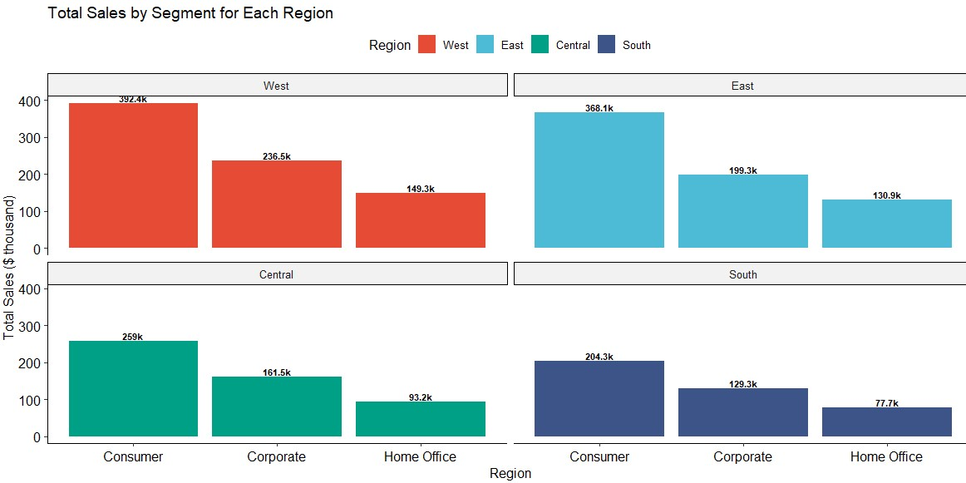
2a. Total Sales by Segment for Each Region
Task / Question : How do sales performance vary across different segments within each region?
Purpose: To evaluate the performance of sales across various segments within different regions. By identifying patterns, trends, and discrepancies, the analysis aims to uncover opportunities for improvement, highlight high-performing segments and regions, and provide actionable insights to guide strategic decision-making.
Hypothesis: There are significant differences in sales by segment across regions, suggesting that segments and regions vary substantially in their sales performance.
From a business perspective, this provides strong evidence that sales strategies differ considerably between segments and regions.
Insights: The West is the top-performing region, achieving Total Sales of $778.3 million, while the South lags with approximately $411.2 million in Sales. Additionally, the Consumer Segment excels with Total Sales of approx. $1.22 million, whereas Home Office is the least performing category, totaling $451.3 thousand in Sales.
In all, Consumer from the West is the most performing with Total Sales of $392.4 thousand.
Olumide Balogun +234-8065060691
8

Slide 10
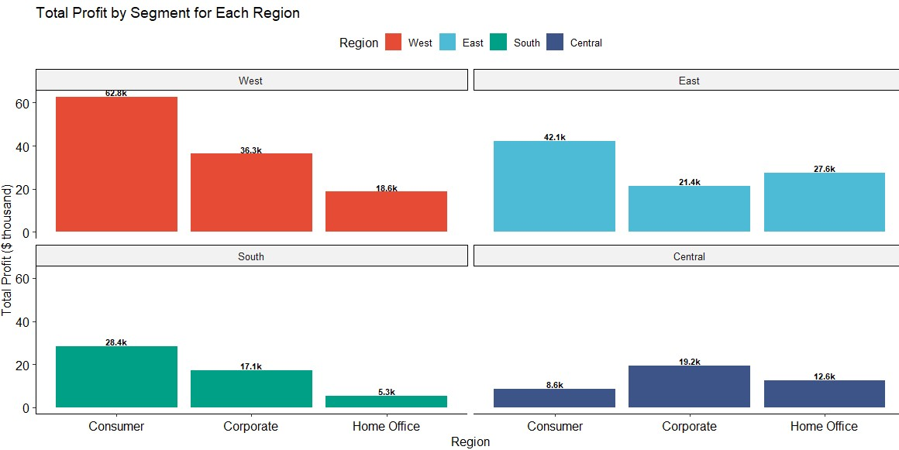
2b. Total Profit by Segment for Each Region
Task / Question : How do profit performance vary across different segments within each region?
Purpose: To evaluate the performance of profit across various segments within different regions. By identifying patterns, trends, and discrepancies, the analysis aims to uncover opportunities for improvement, highlight high-performing segments and regions, and provide actionable insights to guide strategic decision-making.
Hypothesis: There are significant differences in profit by segment across regions, suggesting that segments and regions vary substantially in their profit performance.
From a business perspective, this provides strong evidence that sales and profit strategies differ considerably between segments and regions.
Insights: The West is the top-performing region, achieving Total Profit of $117.7 thousand, while the Central lags with approximately $40.5 thousand in Profit. Additionally, the Consumer Segment excels with Total Profit of $141.9 thousand, whereas Home Office is the least performing category, totaling $64.0 thousand in profit.
In all, Consumer from the West is the most performing with Total Profit of $62.8 thousand.
Olumide Balogun +234-8065060691
9

Slide 11
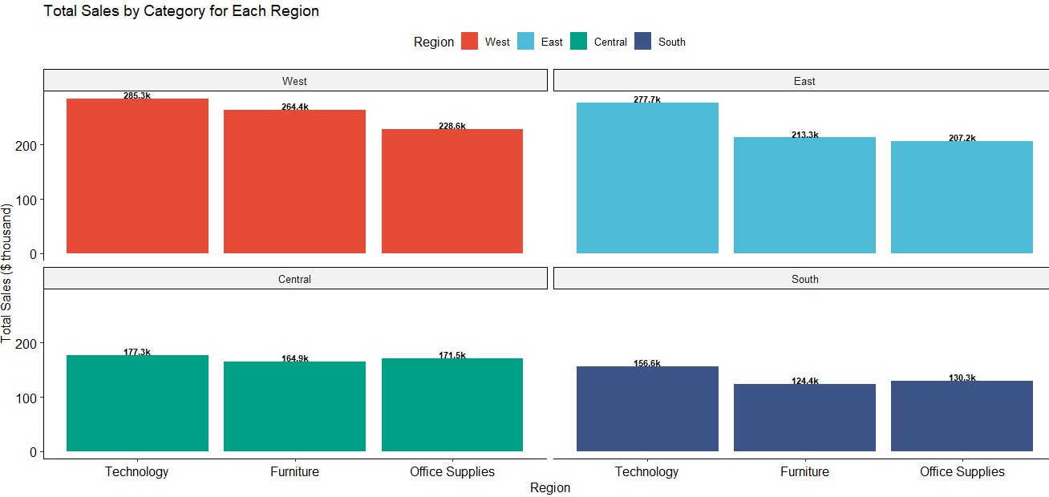
3a. Total Sales by Category for Each Region
Task / Question : How do sales performance vary across different product categories within each region?
Purpose: To examine the sales performance across various product categories and regions. By identifying key trends, variations, and under- performing categories or regions, this analysis seeks to uncover insights that can drive business strategy, optimize resource allocation, and highlight areas for targeted improvements or further investigation.
Hypothesis: There are significant differences in sales by category across regions, suggesting that categories and regions vary substantially in their sales performance. From a business perspective, this provides strong evidence that sales strategies differ considerably between categories and regions.
Insights: The West is the top-performing region, achieving Total Sales of $778.3 million, while the South lags with approximately $411.2 million in Sales. Additionally, the Technology Category excels with Total Sales of $896.8 thousand, whereas Office Supplies is the least performing category, totaling $737.7 thousand in Sales.
In all, Technology from the West is the most performing with Total Sales of $285.3 thousand.
Olumide Balogun +234-8065060691
10

Slide 12
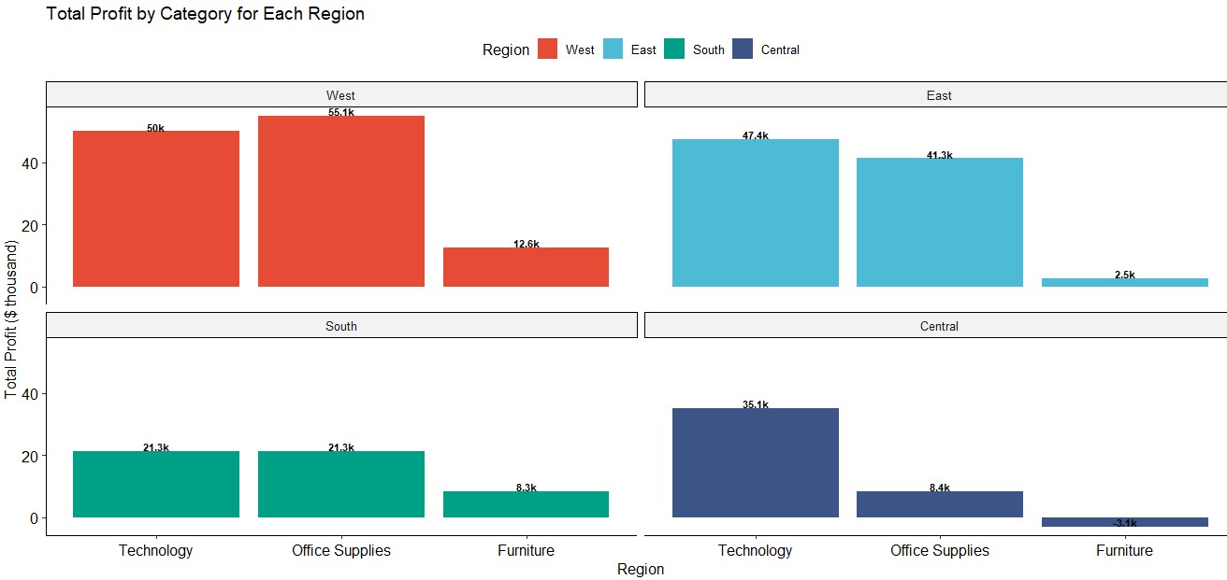
3b. Total Profit by Category for Each Region
Task / Question : How do profit performance vary across different product categories within each region?
Purpose: To examine the profit performance across various product categories and regions. By identifying key trends, variations, and under- performing categories or regions, this analysis seeks to uncover insights that can drive business strategy, optimize resource allocation, and highlight areas for targeted improvements or further investigation.
Hypothesis: Profit varies significantly by category across regions, indicating substantial differences in profit performance.
From a business perspective, this provides strong evidence that profit strategies differ considerably between categories and regions.
Insights: The West is the top-performing region, achieving Total Profit of $117.7 thousand, while the Central lags with approximately $40.5 thousand in profit. Additionally, the Technology Category excels with Total Profit of $153.8 thousand, whereas Office Supplies is the least performing category, totaling $20.3thousand in Profit.
In all, Office Supplies from the West is the most performing with Total Profit of $55.3 thousand.
Olumide Balogun +234-8065060691
11

Slide 13
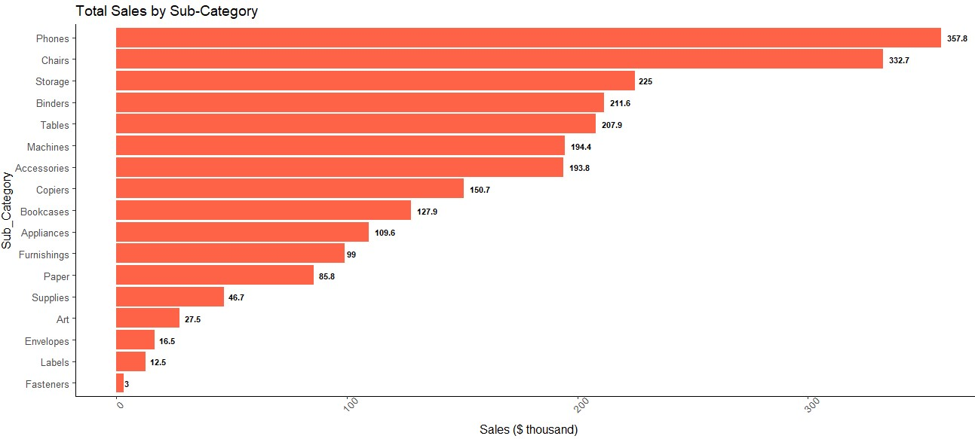
4a. Total Sales by Sub-Category
Task / Question : How do sales performance vary across different sub-categories?
Purpose: To explore the sales performance across various sub-categories. By identifying high-performing and under-performing sub-categories, the analysis aims to uncover valuable insights that can inform product strategies, optimize inventory and pricing decisions, and highlight areas for improvement or investment opportunities within the business.
Hypothesis: Sales show significant variation across sub-categories, reflecting substantial differences in performance.
From a business perspective, this strongly suggests that sales strategies vary significantly across sub-categories.
Insights: Phones and Chairs led the sub-categories in revenue generation, contributing $357.8K and $333K, respectively. Meanwhile, Storage, Binders, Tables, Machines, and Accessories also exhibit strong and promising revenue potential. In contrast, Art ($27.5K in sales), Envelopes ($18.5K in sales), Labels ($12.5K in sales), and Fasteners ($3.0K in sales) rank as the underperforming sub-categories.
Olumide Balogun +234-8065060691
12

Slide 14
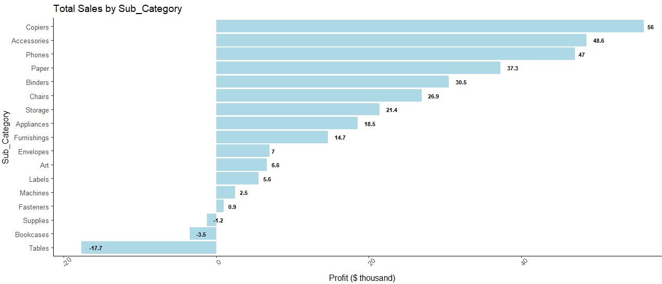
4b. Total Profit by Sub-Category
Task / Question : How do profit performance vary across different sub-categories?
Purpose: To explore the profit performance across various sub-categories. By identifying high-performing and under-performing sub-categories, the analysis aims to uncover valuable insights that can inform product strategies, optimize inventory and pricing decisions, and highlight areas for improvement or investment opportunities within the business.
Hypothesis: Profit exhibits notable variation across sub-categories, highlighting substantial differences in performance. This indicates that profit strategies differ significantly across these sub-categories from a business perspective.
Insights: Copiers, Accessories, and Phones are the top three most profitable sub-categories, with Copiers generating $56K in profit, Accessories $48.6K, and Phones $47K. Additionally, Paper, Binders, and Chairs demonstrate strong profit potential. However, Bookcases and Tables are underperforming, with both generating negative profit.
Olumide Balogun +234-8065060691
13

Slide 15
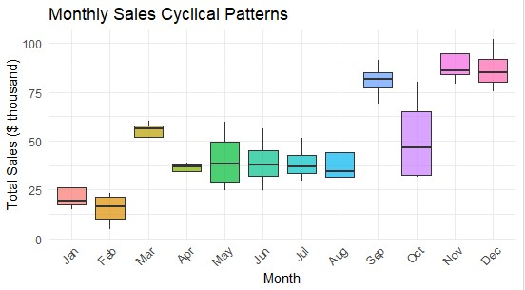
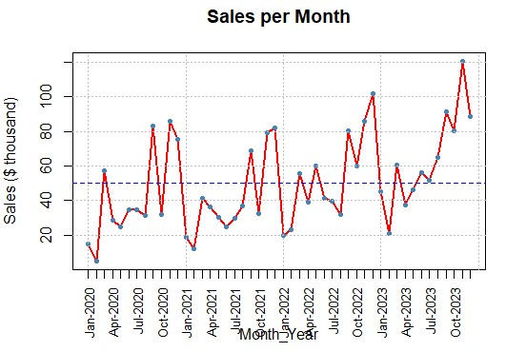
5. Total Monthly Sales: Cyclical Patterns and Month-over-Month Sales Comparison
Task / Question : Can a distinct upward or downward trend in sales performance be identified over time?
Purpose: To examine sales performance over time in order to identify long-term trends, assess whether the business is experiencing growth or decline and evaluate the sustainability of its sales stream. The insights derived from this analysis aim to detect early warning signs of potential decline and inform strategic decisions that can optimize future performance and business direction.
Hypothesis: The p-values indicate statistically significant differences in monthly and yearly sales performance. This demonstrates that sales trends vary substantially throughout the year, and these variations are driven by a variety of factors.
Insights:
CYCLICAL PATTERNS: December, November, and September emerged as the top-performing months, with March and October also showing strong sales results. In contrast, January and February were the lowest-performing months.
MONTH-OVER-MONTH: Although overall growth has been flat, 2023 data shows improved sales performance with higher highs and higher lows. The average sales have consistently exceeded $50,000, reflecting a positive upward trend.
Olumide Balogun +234-8065060691
14

Slide 16
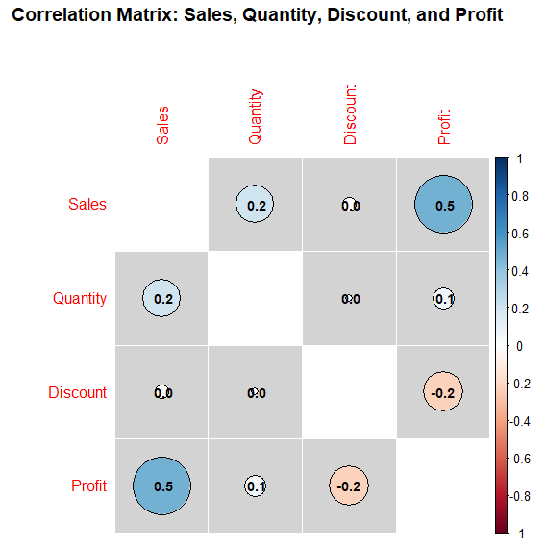

6. Correlation among Sales, Profit, Quantity, and Discount
Task / Question : How do the variables correlate with each other, and what is the strength and direction of these relationships?
Purpose: To explore and quantify the relationships between variables, assessing the strength and direction of these correlations. By applying significance testing and confidence intervals, the analysis ensures statistical rigor, providing reliable insights and enabling informed interpretations of the data.
p-values from significance tests of correlations
Insights:
Sales and Profit show the strongest and significant positive relationship (r = 0.48). Drive sales to boost profits.
Discount and Profit have a weak but significant negative relationship (r = -0.22), indicating that excessive discounts might reduce profitability. Discount strategies need to be re-evaluated.
The relationship between Quantity and Discount is not significant, suggesting discounts do not strongly influence the number of items sold. Focus on Increasing Quantity Sold Strategically
Olumide Balogun +234-8065060691
15

Slide 17
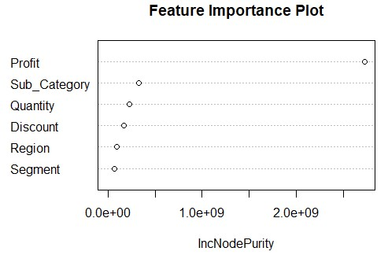
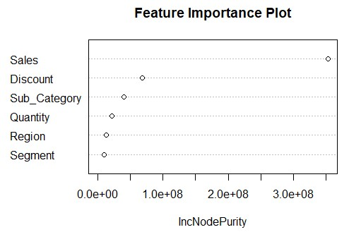
7. Key Drivers of Sales Performance and Profitability
Task / Question : What are the key drivers that significantly contribute to sales performance and profitability?
Purpose: To identify the key factors that significantly influence sales performance and profitability. By using feature importance and regression analysis, the goal is to provide businesses with actionable insights that help optimize strategies and make informed decisions to improve overall sales performance and profitability.
1. Key Sales Performance Drivers
Insights from Feature Importance and Regression Analysis:
Sales Performance Drivers: Profit, specific subcategories (such as Copiers, Machines, and Tables), and Quantity are the main drivers of Sales. While Discount also has a positive effect on Sales, it’s important to be cautious, as excessive discounts could negatively impact profitability.
Profit Performance Drivers: Sales, Discount, and key subcategories like Binders, Bookcases, Chairs, and Copiers drive Profit. While Discounts positively impact Profit, excessive discounting could reduce profitability. Quantity negatively affects Profit, suggesting that higher sales volumes may come with lower margins or increased costs, like production or shipping.
2. Key Profit Performance Drivers
Olumide Balogun +234-8065060691
16

Slide 18
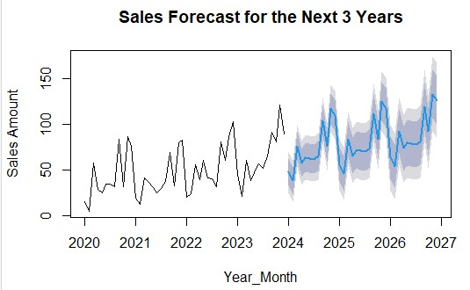
8. Projection of sales for the next thirty-six months – using the ARIMA model
Task / Question : What are the predicted sales trends for the next 36 months, and how can these insights be leveraged to drive favourable business decisions?
Purpose: To forecast sales trends for the next 36 months using time series analysis. These insights aim to support data-driven decision-making in key areas such as pricing, marketing, and resource allocation, enabling businesses to optimize strategies and achieve favourable financial outcomes.
Insights:
Sales are expected to consistently grow from 2024 to 2026, with monthly increases. For instance, January sales rise from 47.56 in 2024 to 63.59 in 2026, and December sales increase from 109.28 to 125.31. Seasonal peaks are evident, particularly in September and November, where September 2024 starts at 103.11 and grows to 119.15 by 2026. Overall, the forecast shows steady growth with some seasonal spikes, indicating a strong year-on-year upward trend.
Business Actionable Insight:
The company should plan for higher demand during peak months (e.g., September, November) and adjust inventory and production. They should also investigate the factors driving seasonal sales increases to optimize operations
Olumide Balogun +234-8065060691
17

Slide 19
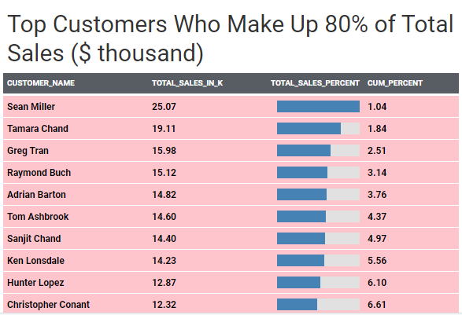
9. Top Customers Driving 80% of Total Sales
Task / Question : Which customers account for 80% of the business’s total sales?
Purpose: To identify the key customers who contribute significantly (80%) to total sales. By prioritizing these high-value customers, businesses can optimize engagement strategies, allocate marketing resources efficiently, and implement retention plans to foster growth, maximize revenue, and build long-term success.
The top 10 customers among the 392 customers driving 80% of total sales
Insights:
Out of 793 total customers, 392 customers contribute to 80% of the total sales, meaning approximately 49.4% of the customers account for 80% of the sales.
The top 10 customers within this group of 392 driving 80% of the total sales are: Sean Miller, Tamara Chand, Greg Tran, and others.
Business Actionable Insight: The 392 customers driving 80% of total sales are the core revenue generators. Prioritizing these customers with targeted relationship management, personalized marketing, and optimized service can strengthen loyalty and drive further growth.
For customers outside this top 80%, alternative strategies like promotions, upselling, or outreach campaigns could help boost their engagement and sales contribution.
Olumide Balogun +234-8065060691
18

Slide 20
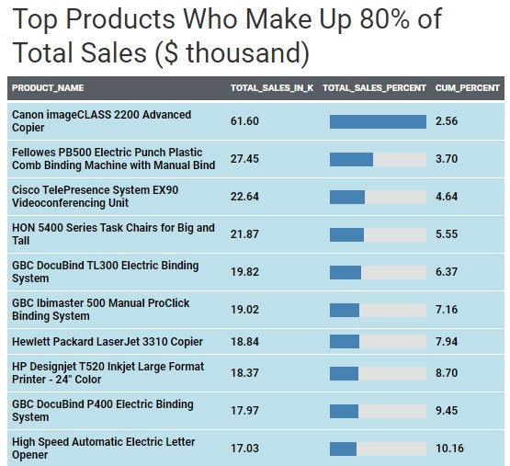
10. Top Products Driving 80% of Total Sales
Task / Question : Which products contribute to 80% of the business’s total sales?
Purpose: To identify the key products that contribute to 80% of total sales. By focusing on these high-value products, businesses can optimize engagement strategies, allocate marketing resources more effectively, and develop retention plan that drive growth, maximize revenue, and support long-term success.
The top 10 products among the 422 products driving 80% of total sales
Insights:
Out of 1,894 products, 422 products contribute to 80% of the total sales, meaning approximately 22.3% of the products account for 80% of the sales.
Business Actionable Insight: The 422 products driving 80% of total sales are the core revenue generators. Prioritizing these products with targeted relationship management, personalized marketing, and optimized service can strengthen loyalty and drive further growth.
Products outside this top 80% may represent lower-priority opportunities for growth or could benefit from alternative strategies aimed at increasing their contributions, such as promotions, upselling, or outreach campaigns to boost engagement and spending.
Olumide Balogun +234-8065060691
19

Slide 21
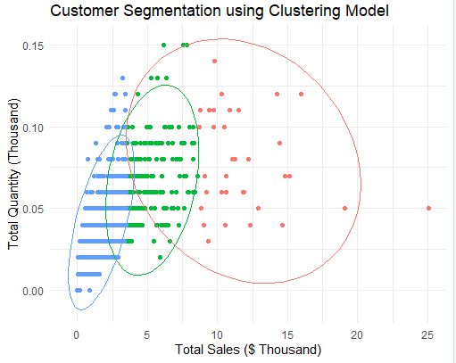
11. Customer Segmentation and Clustering
Task / Question : Which customer segments, based on clustering, contribute the most to overall sales and quantity?
Purpose: To identify the customer segments that generate the highest sales and quantities, using clustering techniques to uncover trends and insights. This will enable businesses to optimize resource allocation, target marketing efforts more effectively, and tailor customer engagement strategies to drive profitability and growth.
Insights:
Three distinct customer clusters are identified:
1st Cluster (blue): Low sales quantity and low sales, representing occasional or low-spending customers.
2nd Cluster (green): Moderate sales quantity and sales, indicating middle-tier customers with more frequent purchases and moderate spending.
3rd Cluster (pink): High sales quantity and high sales, representing the most valuable, high-loyalty customers contributing most of the revenue and sales volume.
Top three Customers:
Sean Miller leads with $25.07K in sales and 0.05K units sold
Tamara Chand follows with $19.11K in sales and 0.05K units sold.
Greg Tran ranks third with $15.98K in sales and 0.12K units sold.
Olumide Balogun +234-8065060691
20

Slide 22
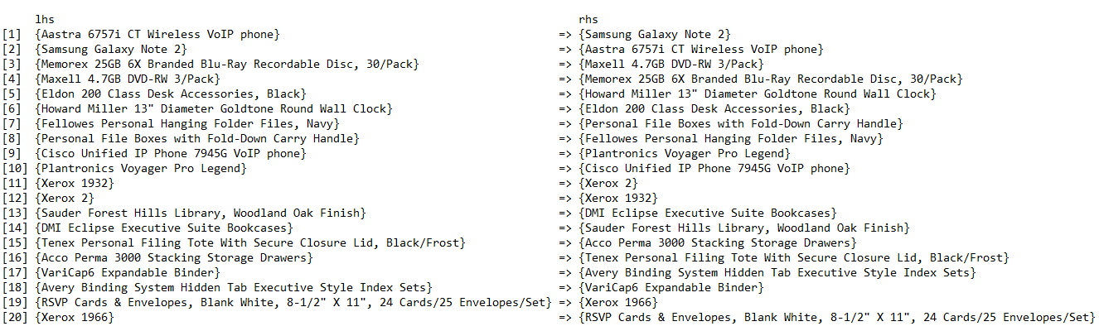
12. Market Basket Analysis: Uncovering Customer Purchase Patterns
Task / Question : What are the most common patterns and associations in customer purchases (e.g. frequently bought items together)?
Purpose: To uncover hidden relationships and patterns in customer purchases using market basket analysis. By understanding which products are often bought together, businesses can optimize sales strategies, improve product recommendations, enhance promotions, and make data-driven decisions to maximize revenue, improve customer satisfaction, and increase operational efficiency.
Top 20 Customer Purchase Patterns for Strategic Sales Optimization
Insights:
Strong Associations: Certain products demonstrate strong pairwise associations with 100% confidence, indicating they are always purchased together. Examples include:
Aastra 6757i CT Wireless VoIP Phone and Samsung Galaxy Note 2.
Memorex Blu-Ray Recordable Discs and Maxell DVD-RW.
Eldon Desk Accessories and Howard Miller Wall Clocks. These patterns highlight complementary relationships between these items.
Mutual Dependencies: Several product pairs exhibit bidirectional dependencies, where purchasing one item guarantees the purchase of the other (e.g., Samsung Galaxy Note 2 and Aastra VoIP Phone). Such relationships can be effectively utilized for reciprocal product recommendations.
Olumide Balogun +234-8065060691
21

Slide 23

Final Recommendations
Yearly Breakdown of Sales, Quantities, Profits, and Percentage Growth
Action Plan: Investigate the drivers behind the exceptional growth in 2023 to replicate success. Address challenges from 2021 (e.g., supply chain or competition) by optimizing operations and revising strategies to sustain profitability and sales growth.
Expected Impact:
Revenue Growth: 10-15% annual improvement by replicating successful strategies from 2023.
Profitability: 8-10% increase in profit margins by addressing operational inefficiencies.
Operational Stability: 15% reduction in disruptions from supply chain or competitive challenges
2. Sales and Profit by Segment for Each Region
Action Plan: Leverage insights about high-performing regions and segments:
West & Consumer Segment: Enhance marketing strategies and allocate resources to sustain leadership.
South Region & Home Office Segment: Reevaluate strategies to uplift sales and profit in these areas. Consider targeted promotions and improved service offerings.
Expected Impact:
Regional Sales Growth: 12-18% increase in South region sales through targeted interventions
Profitability: 10% rise in overall regional profit margins.
Segment Leadership: 15% growth in Consumer segment sales across all regions.
Olumide Balogun +234-8065060691
22

Slide 24
3. Sales and Profit by Category for Each Region
Action Plan: Focus investments in:
Technology Category for maximizing sales and profitability.
Address performance gaps in Office Supplies by reviewing pricing and inventory management.
Expected Impact:
Category Revenue Growth: 20% increase in Technology category sales through focused strategies.
Profitability: 12-15% boost in margins for Office Supplies by optimizing pricing and reducing costs.
Market Share: 5% gain in target regions
4. Sales and Profit by Sub-Category
Action Plan: Prioritize high-performing sub-categories like Phones, Chairs, and Copiers. Optimize pricing and inventory for underperforming sub-categories such as Art, Labels, and Tables to boost their contribution.
Expected Impact:
Sub-Category Growth: 25% revenue boost
Profitability: 10% rise in profit margins.
Inventory Optimization: 15% reduction in costs from better stock management of slow-moving items.
5. Total Monthly Sales: Cyclical Patterns and Trends
Action Plan: Prepare for peak months (e.g., September, November) by adjusting inventory and staffing. Develop strategies to address low-performing months (January, February) with targeted campaigns and promotions.
Olumide Balogun +234-8065060691
23

Slide 25
Expected Impact:
Revenue Growth: 18-22% sales increase during peak months and 10% increase during off - peak months.
Operational Efficiency: 15% improvement in inventory turnover during peak and off-peak months.
6. Correlation among Sales, Profit, Quantity, and Discount
Action Plan: Boost profitability by increasing sales, optimizing discount strategies for long-term gains, and adopting volume-based approaches to enhance margins and reduce costs
Expected Impact:
Revenue Growth: 12-15% increase by optimizing discount structures to boost sales.
Profitability: 10% margin improvement through controlled discount strategies.
Sales Volume: 8% increase in quantity sold through strategic sales campaigns.
7. Key Drivers of Sales and Profitability
Action Plan: Focus on profit, quantity, and key sub-categories like copiers and machines by optimizing discount strategies, maintaining margins, and enhancing operational efficiencies to manage high-volume costs.
Expected Impact:
Sales Growth: 20% improvement by focusing on high-performing sub-categories (e.g., Copiers, Machines).
Profitability: 10% margin increase through refined discounting strategies.
Operational Cost Efficiency: 15% cost reduction through optimized high-volume sales processes.
Olumide Balogun +234-8065060691
24

Slide 26
8. Sales Projection for the Next 36 Month
Action Plan: Prepare for consistent sales growth by scaling inventory and marketing during peak months and allocating resources to sustain forecasted upward trends.
Expected Impact:
Revenue Growth: 20-25% year-over-year increase through 2026.
Profitability: 10% rise in profit margins due to better seasonal planning.
Market Share: 8% increase driven by alignment with projected demand trends.
9. Top Customers Driving 80% of Sales
Action Plan: Enhance customer engagement by creating loyalty programs and personalized marketing for top customers while designing campaigns to increase contributions from lower-tier customers.
Expected Impact:
Customer Retention: 25% increase in repeat business from the top 392 customers.
Revenue Growth: 10% uplift from targeted campaigns for non-core customers.
Customer Loyalty: 20% improvement through personalized engagement strategies.
10. Top Products Driving 80% of Sales
Action Plan: Focus on high-value products with targeted marketing and inventory planning while improving low-performing products' contributions through bundling, discounts, or promotions.
Olumide Balogun +234-8065060691
25

Slide 27
Expected Impact:
Revenue Growth: 15% increase from prioritized high-value products.
Profitability: 12% margin improvement through optimized product mix.
Market Share: 5% rise in targeted categories driven by high-performing products.
11. Customer Segments Based on Clustering
Action Plan: Retain high-value customers with exclusive offers, encourage increased spending from moderate-tier customers, and attract low-spending customers with affordable products or promotions to boost loyalty and frequency.
Expected Impact:
Customer Retention: 30% improvement among high-loyalty customers (Cluster 3).
Sales Volume: 20% increase from moderate-tier customers (Cluster 2).
Revenue Growth: 15% uplift from strategies targeting occasional buyers (Cluster 1).
12. Market Basket Analysis: Customer Purchase Patterns
Action Plan: Focus Leverage product pairings for cross-selling and upselling by creating bundled offers for frequently purchased items.
Expected Impact:
Revenue Growth: 12-18% increase through cross-selling and bundling strategies.
Customer Satisfaction: 20% improvement from personalized product recommendations.
Profitability: 10% margin boost by leveraging complementary product pairings.
Olumide Balogun +234-8065060691
26

Slide 28

Conclusion
These recommendations outline a clear strategy for sustainable growth and profitability. The company is projected to achieve a 15-20% revenue increase, over 10% profit margin growth, and a 12-15% rise in sales volume by 2026. By focusing on product optimization, regional strategies, and operational efficiency, the company will strengthen its market position and long-term success.
With data-driven decision-making, enhanced customer engagement, and streamlined operations, the company is well-positioned to adapt to market changes, boost profitability, and expand its market share.
Explore the Power of Dynamic Dashboards
Unlock insights with Tableau, the cutting-edge data visualization tool I used to design interactive dashboards. These dashboards empower stakeholders to:
Effortlessly analyze sales trends.
Monitor key performance indicators (KPIs) in real time.
Evaluate geographic performance with unmatched clarity and precision.
To explore the dashboard, click on:
https://public.tableau.com/app/profile/olumide.balogun1/vizzes
Select: Superstore - Sales Performance Dashboard
Olumide Balogun +234-8065060691
27

Slide 29
BALOGUN OLUMIDE CHRIS CONTACTS
Tel: +234(0)8065060691
Email: krisbalo11@gmail.com
Github - https://github.com/olumidebalogun1
LinkedIn -https://www.linkedin.com/in/olumide-balogun1/
Medium - https://medium.com/@Olumide-Balogun
X - https://x.com/IAmOluBalogun
Olumide Balogun +234-8065060691

